Slide 1
Image Resizing and Compression
W06- Jess Nelson

Slide 2
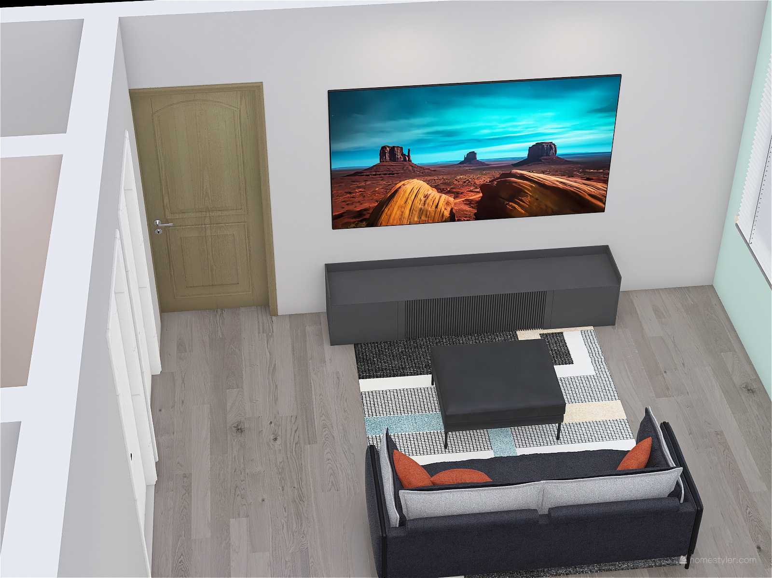
Image Sizing
Is mainly done using CSS, both internal and external.
Size control can be done a myriad of different ways.
Helps with page layout.
Does slow down page rendering.

Slide 3
How do we control an image’s size?
Set height and width properties:
height: 450px;
width: 350px;
Set max height and width:
max-width: 350px;
max-height: 450px;
Other ways to set height/width:
width: auto;
height: 100%;

Slide 4
And there’s more!
background-image
background-size - Size of the image
background-position - Starting position of a background image
object-fit
contain
cover
fill
none
scale-down
object-position

Slide 5
Let’s Practice!

Slide 6
Why Compress?
100 MB
10 MB (exaggerated)
Reduces file size
SEO-friendly
Faster loading speed for website

Slide 7
Image Compression: Lossy vs Lossless
Lossy
Original is replaced with a compressed image.
Referred to as an irreversible compression.
If done correctly, the data loss is not noticeable.
Lossless
Does not lose data; it crams it into smaller sizes.
Favored for archiving because it retains the data.

Slide 8
How to do it:

Slide 9
Sources:
Image Sizing:
https://imagekit.io/blog/how-to-resize-image-in-html/
Image Compression:
https://imagekit.io/blog/image-compression-techniques-in-javascript/

